Slide 1

AI-Powered Emotion-Based Music System
This presentation explores an innovative AI-powered music system designed to adapt to users' emotions in real-time. Traditional music systems often require manual song selection, which can be inefficient. This system aims to provide a seamless, personalized music experience by analyzing facial expressions, voice modulation, and biometric data to curate playlists that match the user's current emotional state.

Slide 2
Problem Addressed: Limitations of Existing Music Systems
Inefficient Manual Selection
Hard-Coded Mood-Based Playlists
Current music systems often require users to manually select songs, which is not efficient or smooth.
Existing mood-based playlists are based on hard-coded tags, not real-time emotional analysis, making them less agile.
Existing music platforms lack the ability to adjust to a person's emotional state in real-time. This system addresses these limitations by using AI to continuously analyze emotions and adjust the playlist accordingly, providing a more immersive and personalized experience.

Slide 3
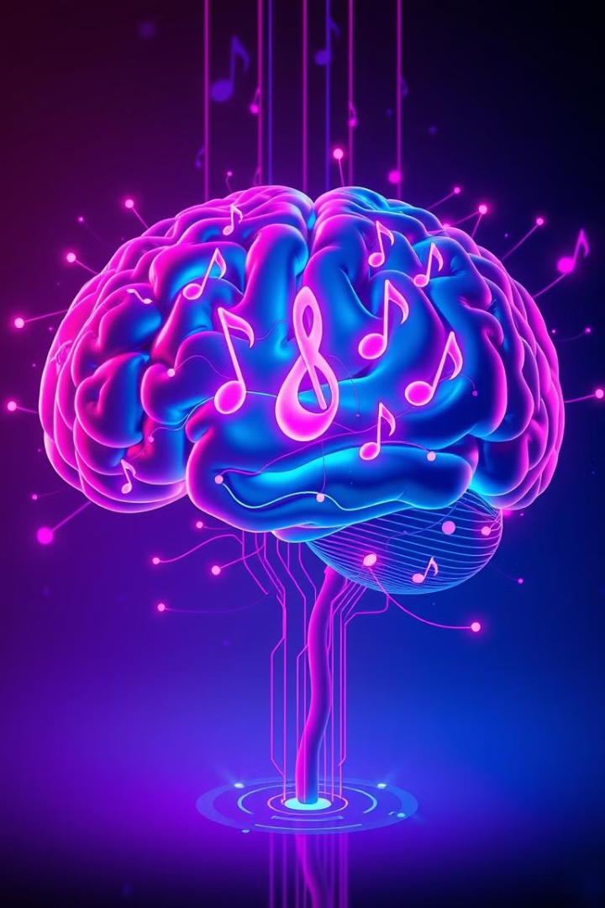



Objective: Real-Time Emotion-Based Music
Identify Emotional Conditions
Curate Corresponding Playlists
Establish an AI-based music system for identifying users' emotional conditions in real-time.
Collect and play a playlist of music that corresponds to the user's current emotional state.
Continuous Analysis
Use AI, IoT sensors, and deep learning algorithms to continuously analyze emotions and adjust the playlist.
The primary objective is to create a system that identifies users' emotional states in real-time and plays music that matches those emotions. This eliminates the need for manual selection and provides a personalized music experience.

Slide 4
State of the Art and Research Gap
Patent Number
Title
Difference
US10286654B1
Emotion Recognition System for Music Recommendation
Integrates voice modulation analysis, biometric tracking, and real-time adaptive playlist management.
US9876543B2
AI-Powered Music Selection
Works autonomously, continuously adapting based on real-time biometric and emotional inputs.
JP5567893B2
Adaptive Music Recommendation System
Works dynamically in real-time, detecting immediate emotions and changing the playlist instantly.
US5067890A
Voice-Based Mood Analysis
Combines multiple data points (facial, voice, and biometric) for higher accuracy and seamless automation.
While existing systems analyze facial expressions or voice tones, this system enhances these methods by integrating voice modulation analysis, biometric tracking, and real-time adaptive playlist management for a highly dynamic experience.

Slide 5




Key Components and Functionalities
Emotion Detection Module
Monitors physiological and behavioral indicators to determine the user's emotional state.
AI Music Recommendation Engine
Selects the most appropriate music based on the detected emotional state.
Smart Playback Control Module
Dynamically adjusts audio settings to enhance the listening experience.
The system incorporates an emotion detection module, an AI music recommendation engine, and a smart playback control module. These components work together to provide a seamless and engaging listening experience tailored to the user's emotional state.

Slide 6




Emotion Detection Module: AI-Driven Technologies
Facial Recognition
Voice Recognition
Biometric Sensors
The emotion detection module uses facial recognition, voice recognition, and biometric sensors to determine the user's emotional state. AI-powered cameras scan facial expressions, advanced voice analysis assesses tone, and biometric sensors track physiological metrics like heart rate and skin temperature.

Slide 7



AI Music Recommendation Engine: Deep Learning-Based Selection
Real-Time Adaptive Playlists
The system creates dynamic playlists that adjust according to the user's current emotional state.
2
Analyze Millions of Songs
AI algorithms analyze millions of songs and categorize them based on their emotional impact, tempo, lyrics, and instrumentation.
1
Integration with Streaming Services
3
The platform supports integration with leading streaming services and local music libraries.
The AI music recommendation engine uses deep learning models trained on extensive datasets to establish precise emotion-to-music mappings. It analyzes millions of songs and categorizes them based on their emotional impact, tempo, lyrics, and instrumentation.

Slide 8

Advantages of the Invention
Adaptive Real-Time Music Streaming
Multi-Sensor Emotional Analytics
Plays music dynamically without requiring user input, adjusting the playlist based on the user’s emotional state.
Utilizes facial recognition, voice tone analysis, and internal sensors to detect and analyze emotions in real-time.
Enhanced Productivity and Well-Being
Offers specialized music for different activities, such as high-energy beats for workouts and focus-enhancing tracks for concentration.
The system offers adaptive real-time music streaming, multi-sensor emotional analytics, and enhanced productivity and well-being. It adjusts song order, playback speed, and volume based on the user’s emotional state, ensuring a fluid and immersive listening experience.

Slide 9
Potential Chances of Commercialization
1
Licensing to Music Platforms
2
Integration with IoT Devices
3
Partnerships with Wearable Tech
The system has potential for commercialization through licensing to music streaming platforms, integration with smart speakers and IoT devices, and partnerships with wearable tech companies. It can also be implemented in automotive infotainment systems and mental health applications.

Slide 10

Expansion and Future Development
1
2
3
Enveloping AI Models
Integrating Biometric Sensors
Creating APIs
For emotion detection and music recommendations.
For real-time emotional feedback.
For seamless connectivity with leading music streaming platforms.
Future development includes enveloping AI models for emotion detection and music recommendations, integrating biometric sensors for real-time emotional feedback, and creating APIs for seamless connectivity with leading music streaming platforms. Testing and refining the system in diverse real-world scenarios is also crucial.

